Slide 1
SENTIMENT ANALYSIS ON Amazon review
Team members JIVITES D- CB.SC.U4AIE24020 RAMKUMAR K R - CB.SC.U4AIE24042 MEHAN- CB.SC.U4AIE24031 SUKANTHAN- CB.SC.U4AIE24056

Slide 2
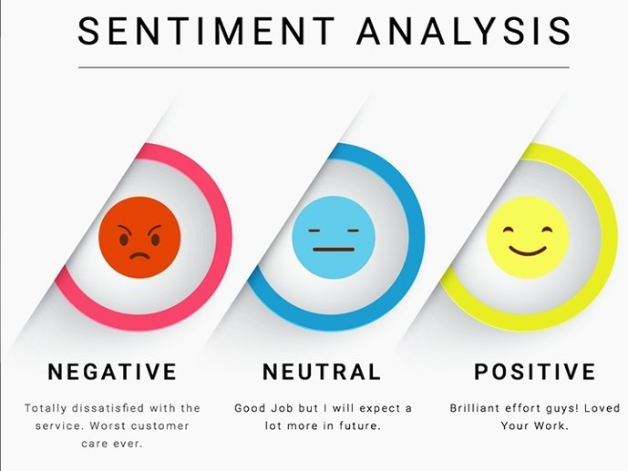
INTRODUCTION
Sentiment analysis is an NLP (Natural Language Processing) task that determines the sentiment whether it is a positive statement or Negative statement or neutral statement. For Amazon reviews, it helps identify customer opinions about products or services

Slide 3
PROBLEM STATEMENT
With the rise of e-commerce platforms, customer reviews play a crucial role in influencing purchasing decisions. However, due to the large volume of reviews, it becomes difficult for buyers to manually analyze and interpret customer feedback. Without sentiment analysis, businesses can't easily understand whether customers are happy or unhappy. Missing important feedback to make products or services better.

Slide 4
OBJECTIVES
This project aims to analyze and classify sentiment in textual data using Logistic Regression and Term Frequency-Inverse Document Frequency (TF-IDF) To classify them as positive and negative. It will summarize customer opinions using text summarization techniques and provide a final recommendation (BUY/NOT BUY) based on sentiment analysis

Slide 5
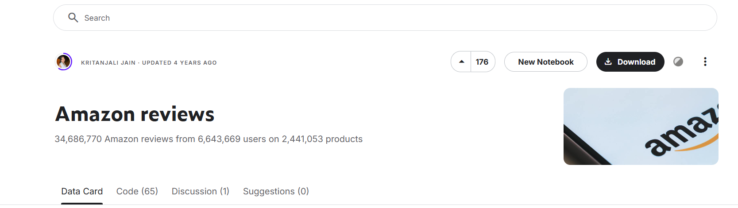
DATASET DESCRIPTION
The amazon reviews dataset Contains 34,686,770 Amazon reviews from 6,643,669 users on 2,441,053 products, from the Stanford Network Analysis Project (SNAP). This subset contains 1,800,000 training samples and 200,000 testing samples in each polarity sentiment. The data span a period of 18 years, including ~35 million reviews up to March 2013. Reviews include product and user information, ratings, and a plaintext review. The Amazon reviews polarity dataset is constructed by taking review score 1 and 2 as negative, and 4 and 5 as positive.
Why we choosed this dataset?
Compared to other dataset ,This dataset was larger and more diverse dataset. This Dataset was not focused on a particular product so it made the model more generalizable. The dataset contains 200,000 training samples and 200,000 testing samples per sentiment class, providing ample data for training machine learning models.

Slide 6
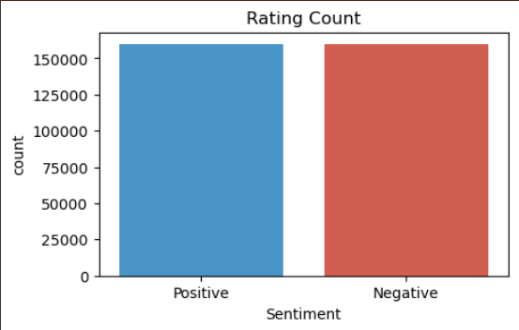
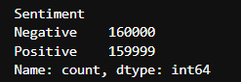
Rating distribution in dataset
The dataset includes user reviews with product details, ratings, and textual feedback. For sentiment classification, reviews with ratings of 1 and 2 are labeled as negative, while ratings of 4 and 5 are considered positive; reviews with a score of 3 are excluded. Compared to prior studies that focus on specific product categories, this dataset enhances model generalizability due to its diversity.
• Polarity- 1 for negative and 2 for positive.
• Title- Review heading.
• Text- User-provided review body.
Negative sentiment has 160,000 entries.
Positive sentiment has 159,999 entries.
The dataset is balanced, ensuring fair model training for sentiment analysis.

Slide 7
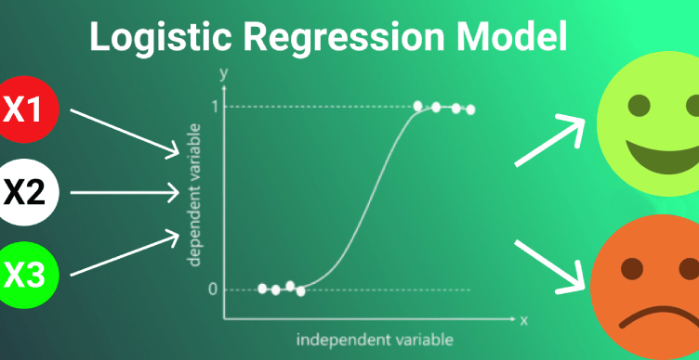
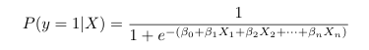
MODEL
LOGISTIC REGRESSION
Logistic Regression is a supervised machine learning algorithm used for classification tasks
Unlike linear regression, it predicts probabilities and maps them to binary outcomes (0 or 1) using the sigmoid function.
It is widely used for sentiment analysis, such as predicting positive or negative sentiments in Amazon reviews.
The algorithm is fast, simple, and efficient for handling large datasets.
P(y =1|X) represents the probability that a given input X belongs to class 1 (positive sentiment).
• β0 is the bias term.
• β1,β2,...,βn are the model coefficients learned during training.
• X1,X2,...,Xn are the input features extracted from the text using TF-IDF.

Slide 8
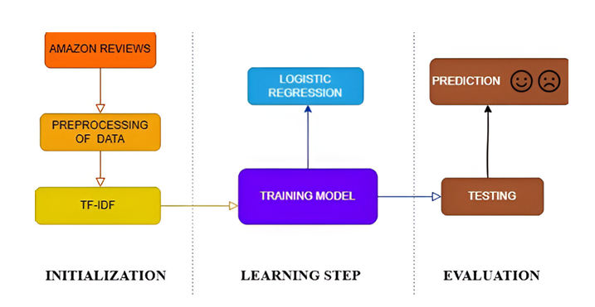
BLOCK DIAGRAM

Slide 9
Methodology
1. DATA ACQUISITION
- Collect Amazon product reviews from Kaggle datasets.
- The dataset includes customer reviews, ratings, and metadata.
• Polarity- 1 for negative and 2 for positive. • Title- Review heading. • Text- User-provided review body.
2.DATA REVIEWING
- Examine the dataset structure to identify missing values.
- Confirm that text columns (like review title and text) are stored as strings.
3. DATA PRE-PROCESSING
• Lowercasing- Converts all text to lowercase to maintain uniformity and prevent duplicate word representations.
• Removing Special Characters and Punctuation- Eliminates non-alphanumeric symbols (e.g., @,!,#) that do not contribute to sentiment analysis.

Slide 10
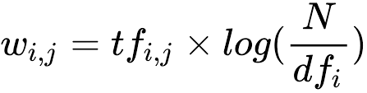
• Tokenize,Stopword Removal - Removes common words such as ”the,” ”is,” and ”and” to enhance focus on meaningful terms. Ex: "The product is really good and I love it!" --> product really good love
• Lemmatization- Converts words to their root form, ensuring consistency across variations of the same term..
4. WORD CLOUD
-Identify and analyze the most frequently occurring words to understand common themes.
- Generate a word cloud to visualize the most common words in positive and negative reviews.
5. FEATURE SELECTION
- Stratified Split: Ensured balanced sentiment distribution in train & test sets.
- Convert text data into numerical form using TF-IDF Vectorization.
6 .Testing, Training
-The dataset is divided into 75% for training and 25% for testing to evaluate model performance effectively.Train the model using Logistic Regression.
7. Model Selection
-Selected Logistic Regression as the classification model. Trained the model on TF-IDF-transformed review data.

Slide 11
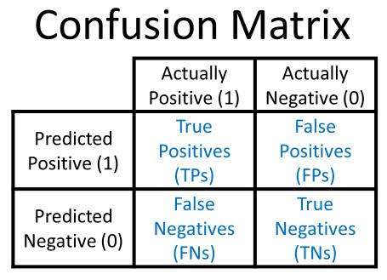
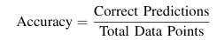
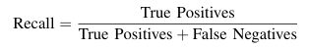
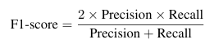
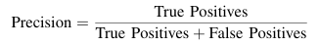
Methodology
8. Confusion Matrix
-Evaluate the model’s performance using a confusion matrix
to analyze correct vs. incorrect predictions.
9. Precision, Recall, F1-Score,Accuracy
-Use standard evaluation metrics:
- Accuracy measures how often the classifier makes the correct prediction.
It is the ratio of correct predictions to the total number of predictions.
- Recall measures how many of the actual positive in sentances in the dataset were correctly predicted by the model.
F1-score combines precision and recall into a single metric, representing their harmonic mean.
Precision quantifies how many of the predicted positive instances are actually correct.

Slide 12
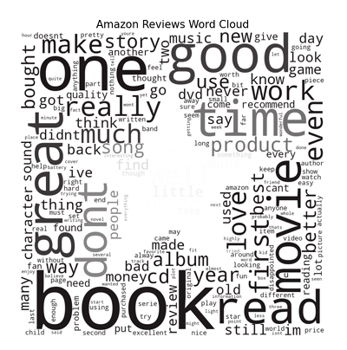
WORD CLOUD
To better understand customer sentiments, a word cloud was generated from Amazon reviews, highlighting the most frequently used words. This visualization helps identify common themes, such as product quality, pricing, and overall customer satisfaction. Words appearing more frequently indicate aspects that users emphasize the most in their reviews.
The word cloud reveals that terms related to ”quality,” ”price,” ”durability,” and ”delivery” are among the most discussed topics in reviews. Positive reviews often include words such as “great,” “excellent,” and “value,” while negative reviews highlight terms like “poor,” “broken,” or “slow.”

Slide 13
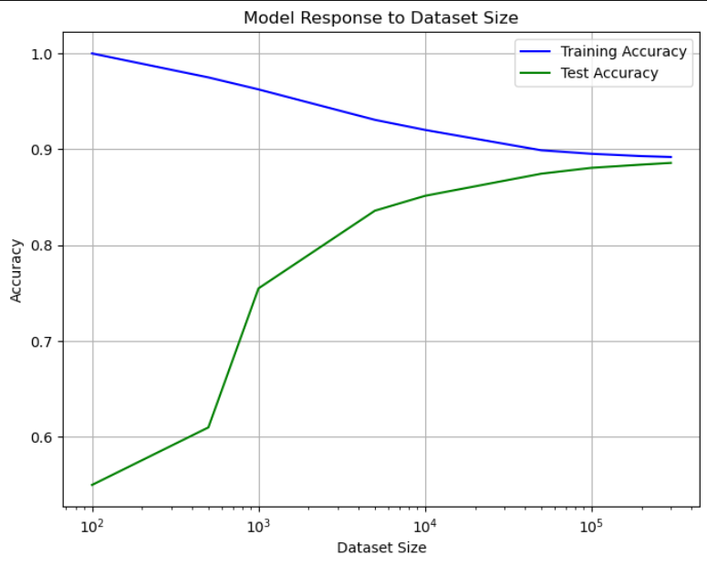
MODEL RESPONSE TO DATASET SIZE
Graph shows how dataset size affects model performance. With small datasets, training accuracy is near 100%, showing overfitting. As the dataset grows, training accuracy drops and stabilizes at 90%, improving generalization. Test accuracy starts low but improves with more data, reaching 88–90%.The gap between training and test accuracy decreases, reducing overfitting. This shows that larger datasets help build better machine learning models.

Slide 14
TEXT SUMMARIZATION
In NLP (Natural Language Processing), text summarization involves condensing lengthy texts into shorter, more concise versions while retaining the most important information and meaning. Extractive Summarization: These methods rely on extracting several parts, such as phrases and sentences, from a piece of text and stack them together to create a summary.
PageRank Algorithm [Inspiration to TextRank Algorithm]: PageRank is used primarily for ranking web pages in online search results. In order to rank these pages, we would have to compute a score called the PageRank score. This score is the probability of a user visiting that page. To capture the probabilities of users navigating from one page to another, we will create a square matrix M, having n rows and n columns, where n is the number of web pages.
The initialization of the probabilities is explained in the steps below:
Probability of going from page i to j, i.e., M[ i ][ j ], is initialized with 1/(number of unique links in web page)
If there is no link between the page i and j, then the probability will be initialized with 0
If a user has landed on a dangling page, then it is assumed that he is equally likely to transition to any page. Hence, M[ i ][ j ] will be initialized with 1/(number of web pages)

Slide 15
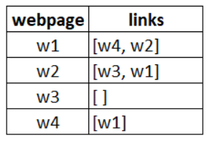
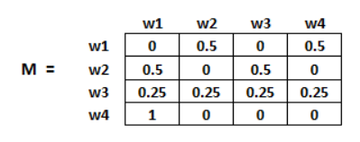
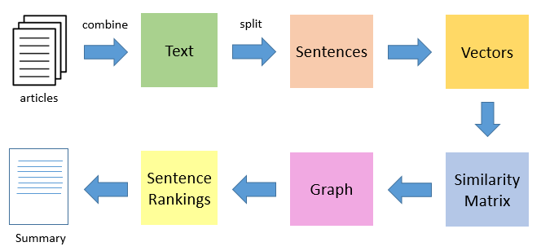
TextRank Algorithm :
In place of web pages, we use sentences
Similarity between any two sentences is used as an equivalent to the web page transition probability
The similarity scores are stored in a square matrix, similar to the matrix M used for PageRank
GloVe (Global Vectors for Word Representation)
is a pre-trained word embedding technique
developed by Stanford.It provides a vector
representaion of words.

Slide 16
RESULTS
The model’s performance was evaluated using key classification metrics:
Accuracy: 89%– The model correctly predicted sentiments for 89% of the reviews, indicating strong overall performance.
Precision: 88.16%– Of all reviews classified as positive, 88.16% were actually positive, demonstrating high reliability in positive sentiment detection.
Recall: 88.85%– The model successfully identified 88.85% of all actual positive reviews, ensuring effective sentiment coverage.
F1-Score: 88.50%– A balanced measure that considers both precision and recall, confirming the model’s robust ness

Slide 17
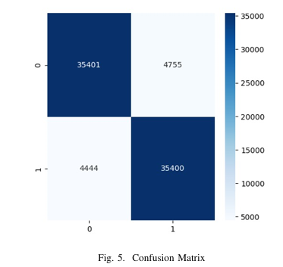
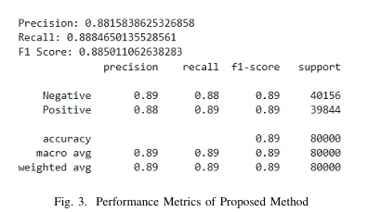
Result's AND METRICS

Slide 18
CONCLUSION
Our sentiment analysis project on Amazon reviews is progressing well, with key milestones such as dataset selection, preprocessing, and initial model implementation completed. Using Logistic Regression with TF-IDF, we have achieved promising classification results, demonstrating the feasibility of our approach. Our current evaluation metrics show an accuracy of 89%, with balanced precision and recall. The final phase will focus on improving sentiment classification accuracy and deriving meaningful insights to enhance customer feedback analysis.
In the next phase, we aim to enhance the sentiment analysis model by integrating text summarization to provide concise insights from multiple reviews. Additionally, we plan to improve classification accuracy and develop a user-friendly UI for seamless interaction.

Slide 19
FUTURE W0RK
Multilingual Sentiment Analysis Extend support for multiple languages to analyze reviews from a diverse global audience.
Aspect-Based Sentiment Analysis Identify sentiment towards specific product features (e.g., battery life, display, delivery).
Deep Learning Models Integration Upgrade from traditional models to LSTM, or BERT for better contextual understanding.

Slide 20
Thank you

